Slide 1
Computer Organization & Assembly Language
Lecture 4

Slide 2
Little Endian and Big Endian
In little endian lower byte store in lower address and higher byte store in higher address.
In High endian lower byte store in higher address and higher byte store in lower address.
Intel 8086 processor is Litter endian.
Example Storing BBDD in memory address 1122h

Slide 3
We can store data in any memory location.
As we study memory address is 20bits
We have 16bit Segment address 16 bit offset.
For offset address we can use BX , SI , DI
For Segment we can use any segment register.
In Assembly code address can be access by segment:[offset].
If we don’t define segment address by default ds is selected
If we store data in 4455h it will be store in DS:[4455].

Slide 4
Storing data in Memory
To Store 1 byte in Memory
Mov byte ptr [offset] , 1
Mov byte ptr Segment:[offset]
To Store 2 byte in Memory
Mov word ptr [offset] , 1
Mov word ptr Segment:[offset]

Slide 5
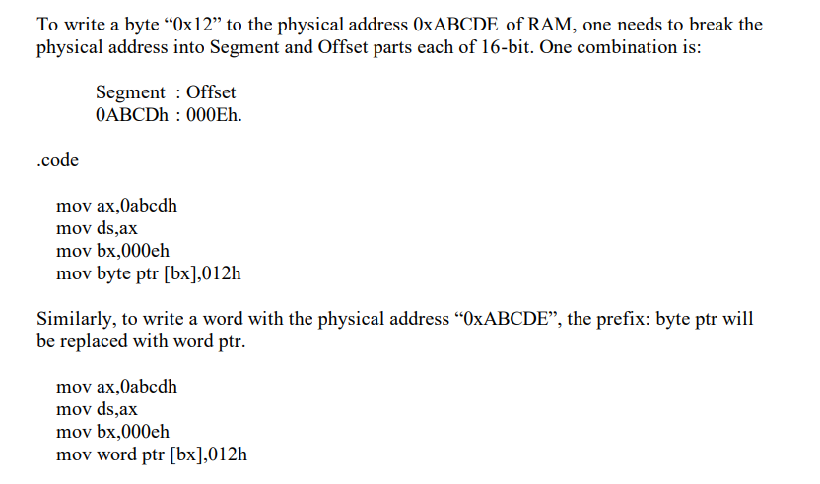

Slide 6
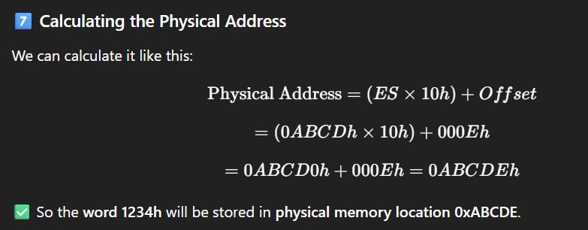
Calculate physical address

Slide 7
Store ABCD at 12345
12345 address is 20 bit address
So our Segment register is 1234 and offset is 0005
Store some data in 2 memory location -> Get data from these locations -> find sum and store sum at any location.

